Slide 1
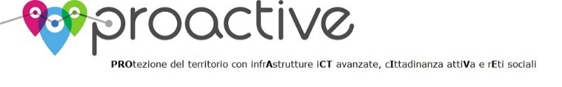

Geo-statistical Exploration of Milano Datasets
Irene Celino and Gloria Re Calegari
CEFRIEL
The 13th International Semantic Web Conference 2014
Riva del Garda, Italy
19 – 23 October 2014
Semantic Statistics workshop
19th October 2014
Notes:
Good morning to everyone!
My name is Gloria and I am going to tell you about the research work I have done with my coleague Irene Celino about the «geo statistical explo of milano dataset»

Slide 2
Research goal
Long term goal
Compare data related to the same city but obtained from heterogeneous sources. Do they provide the same ‘picture’ of the city?
Can we update a dataset (expensive and time consuming, updated once every 5/10 years) with another dataset (cheaper and always up to date)?
Presentation target
Comparison of two heterogeneous datasets referring to the same city (Milan) to discover if they have any intrinsic correlation
Notes:
The long term goal of our research activity is to compare data related to the same city but obtained from heterogeneous sources in order to verify if they provide the same picture of the city.
In this way one could update a dataset, which is expensive …., with another dataset cheaper and always up to date.
More specifically the presentation target is about the comparison of two heterogeneous datasets referring to the same city Milan to discover if they have any intrinsic correlation.

Slide 3
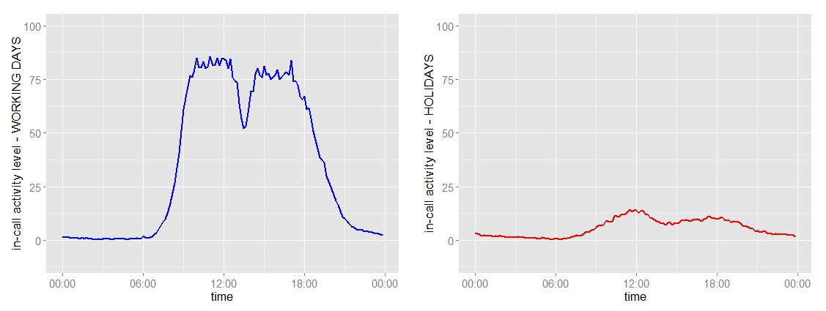
Datasets available
Telecom (phone activity data) provided for their “Big Data Challenge”
Milan + surroundings
Nov-dic 2013
Grid of 10.000 cells
Activity recorded every ten minutes
A footprint for each cell
ISTAT - Italian National Statistical Institute
demographic data of 2011 and 2001
divided by sex, age and nationality
Analysis performed using data in their original format (GeoJSON, csv) and serialization in RDF format at the end of the analysis.
Notes:
The datasets we used in our research project are from telecom and Istat.
Telecom dataset shows the phone activity occurred in two months in the area of Milan and its surroundings.
Milan area is mapped into 10000 cells and every ten minutes, for each cell, the number of incoming/outcoming calls, text messages, internet activity are recorded.
Since we had billions of records to handle, we decided to compress data, making a footprint for each cell, like the one in the picture. The blue line shows footprints of working days whereas the red one records the holidays.
As regards ISTAT data, we have demographic data of each municipality. Data about population are split up by sex age and nationality. This is the dataset provided by the workshop challenge.
These data are analysed in their original format (geoJSON and CSV) and they are serialized in RDF only at the end of analysis process.

Slide 4
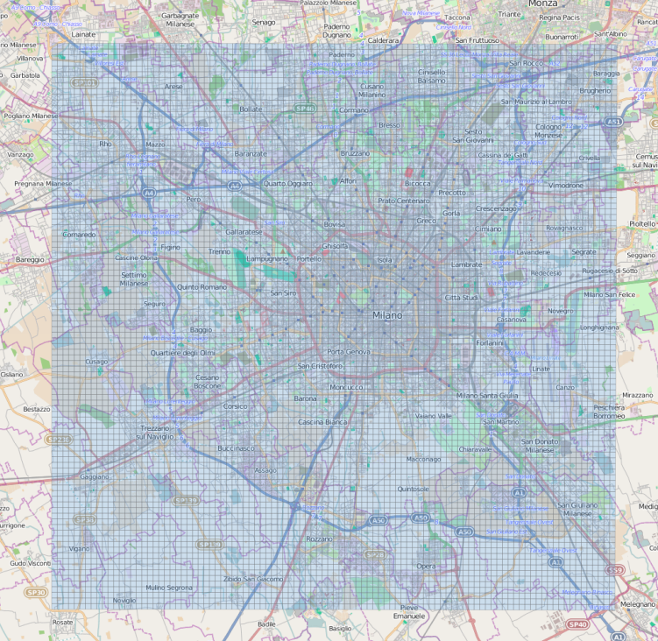
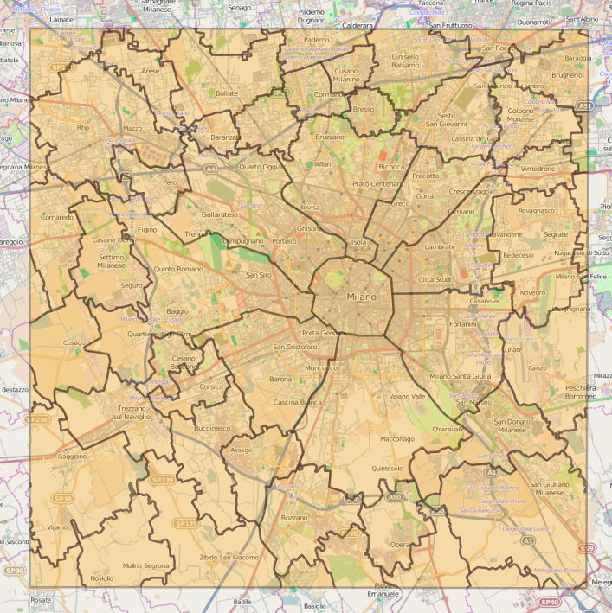
Datasets available – different spatial granularity
Pre-processing of data required.
Mapping of Telecom data into municipality granularity.
Telecom – grid of 10.000 cells (250 x 250 m each)
ISTAT – 50 surrounding towns + 9 internal Milano districts
Notes:
As you can see, The two datasets have two different spatial granularity levels: Telecom data is mapped on a grid of 10.000 squared cells of 250 m.
Whereas ISTAT data is grained more coarsely, actually data are at a municipality level.
As there are such differnces, a pre processing phase is required in order to make data comparable.
In particular we modified Telecom data in order to be at the same spatial granularity of ISTAT data, the municipality level.

Slide 5
Methodology of analysis
Goal of analysis: do the two datasets have the same intrinsic meaning?
Unsupervised clustering to group data in each dataset:
k-means (euclidean distance)
Adaptive k-means (cosine distance)
Comparison of the two clustering results to find correlation between the two datasets.
Validation of the comparison:
Rand Index
Kappa Index
(the closer to 1 the index is, the stronger the correlation between the data clusterings)
Notes:
After pre-processesing data, we went on with the analysis.
Our aim was to find is the two datasets have the same intrinsic meaning.
To do so we apply unsupervised clustering methods to group data in each dataset. In particular we used the k-means and adaptive k-means algorithms which implements both the euclidean and the cosine similarity metric.
We then compare the two clustering results to find correlation between the two datasets.
To validate this comparison we used the Rand and Kappa indexes, which are used in literature for this purpose
The closer to 1 the indexes, the stronger the correlation

Slide 6
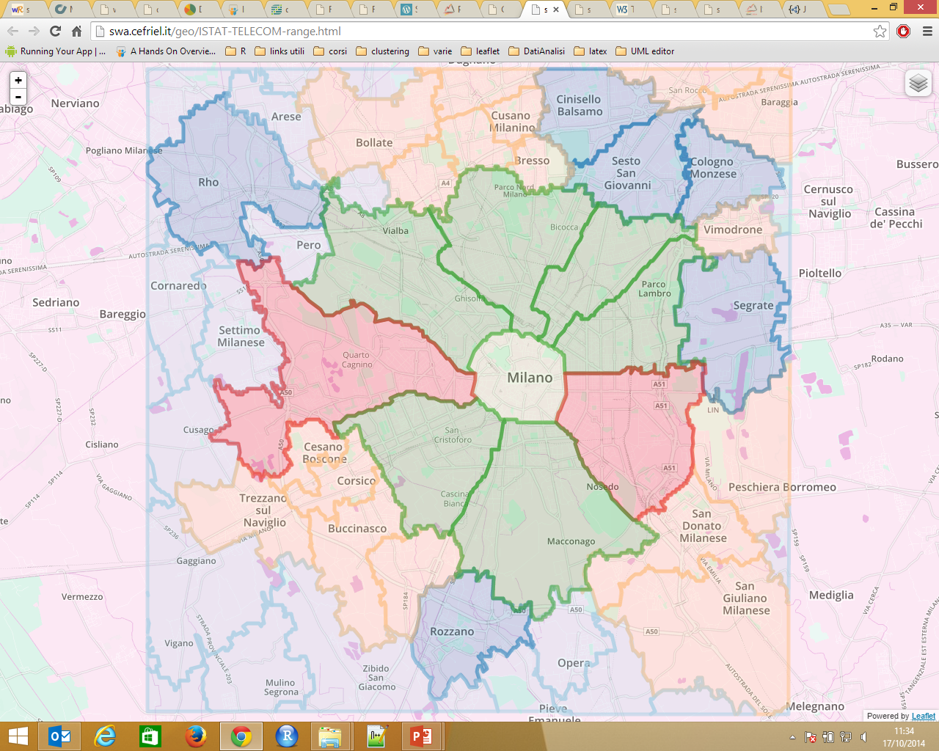
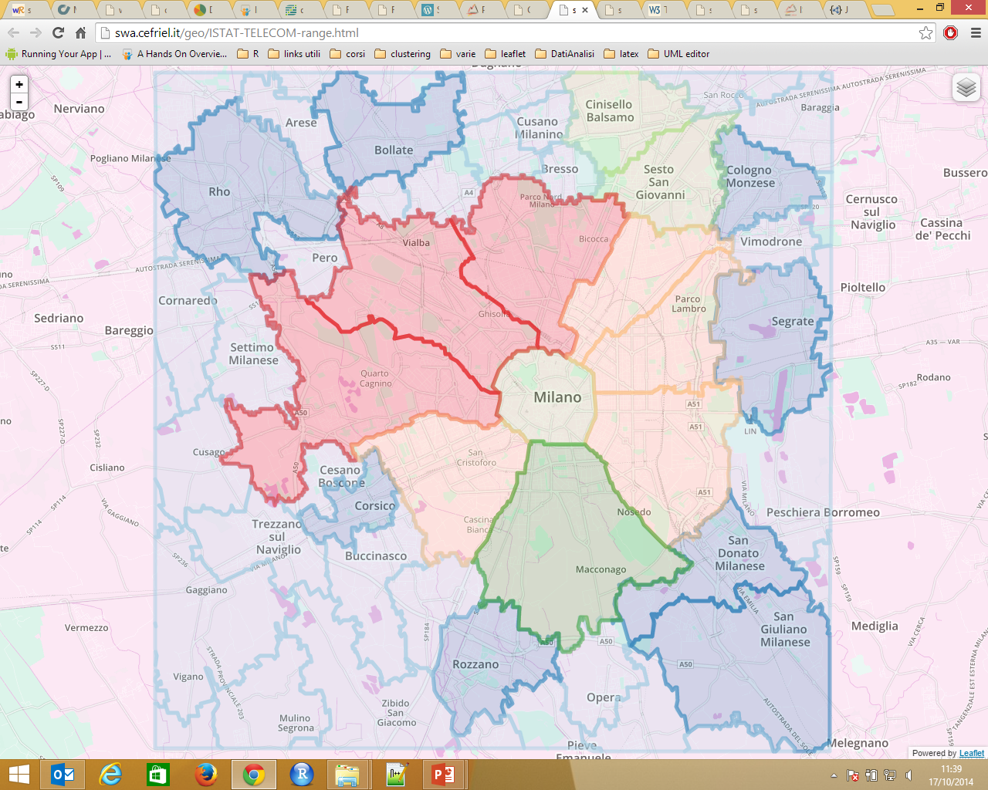
Experiments- Telecom vs ISTAT (range on total poulation)
Rand Index | Kappa Index
0,23 | 0,23
Only partial correlation
Try to add information to total population (feature vector with distribution of populatin divided by sex, age and nationality)
Telecom - Kmeans 6 classes
ISTAT 2011 - range 6 classes
Notes:
The aim of the first experiment was to check if there is a correlation between phone activity and the number of inhabitants of a district.
The two pictures in the slides show the clusters obtained on the two datasets.
On the left clustering on telecom data, on the right partition of the number of inhabitants using range subsetting.
As you can see from the pictures and in the table the correlation between datasets is only partial.
That’s why we did another experiment in which we added more information to the total number of population. This additional information are a feature vector with the distribution of population divided by sex, age and nationality.

Slide 7
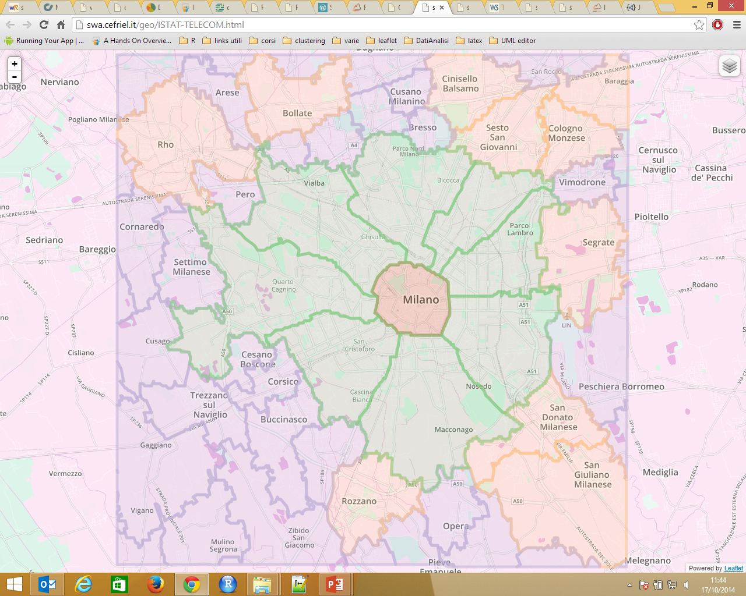
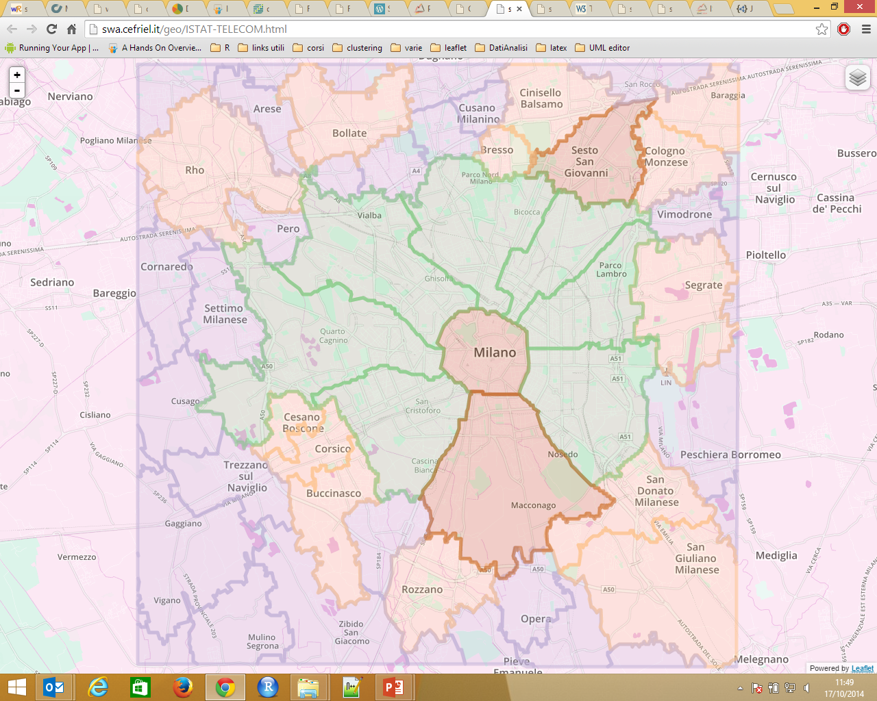
Experiments - Telecom vs ISTAT (2011 fine-grained population)
Rand Index | Kappa Index
0,77 | 0,81
Good correlation
Try to add historical information (2001 datasets).
Does adding temporal dynamic improve corrrelation?
Telecom - Kmeans 4 classes
ISTAT 2011 – Kmeans 4 classes
Notes:
As this data is multi-dimensional, we decided to use clustering algorithms to group data and the best was kmeans tuned with 4 classes.
We had a considerable improvement in terms of Rand and Kappa indexes, which reach the values of .. and …. By looking at the pictures you can see that the clusters are very similar.
At this point, we wonder if adding historical data can improve the correlation,
I mean to verify if adding information about the temporal dynamic improve the correlation.

Slide 8

Experiments- Telecom vs ISTAT (2011+2001 fine-grained population)
Rand Index | Kappa Index
0,77 | 0,81
Good correlation. The same as the previous test.
Telecom - Kmeans 4 classes
ISTAT 2011 + 2001 – Kmeans 4 classes
Notes:
So we added the 2001 istat demographic data to the 2011 data.
And the results obtained are the same as the previous experiment in terms of both Rand and Kappa coefficients and in terms of clusters created.
Summing up, there might exists a correlation between phone activity data and population.
The center of Milan is different from the other part of the city which are the green areas.
Outside there are all the other municipalities of the surrounding (violet and orange groups)

Slide 9

Clustering results serialization
Geographic format
GeoJSON file
Results of clustering
analysis
RDF Data Cube vocabulary (adding in the Observation definition concepts of clustering algo and cluster number)
RDF format
Geo + RDF format
Enrich GeoJSON with power of JSON-LD -> ‘’GeoJSON-LD’’
Notes:
After clustering our data , we focused our attention on the serialization of our clustering results.
As regards the geospatial/geagraphic aspect of data we are able to present our data in the GeoJSON format, which is the standard for geographical information. This is also the standard we used to plot the maps of the previous slides.
Whereas as regards the serialization to RDF format, we successfully used the RDF Data Cube vocabulary to describe clustering results. We add in the definition of Observation the concepts of clustering algorithms and number of cluster.
At this point we would like to merge the two approaches in order to take advantage both of the geographical format geoJSON and the advantages of using Linked data.
To do so we try to enrich GeoJSON with the power of JSON-LD.

Slide 10
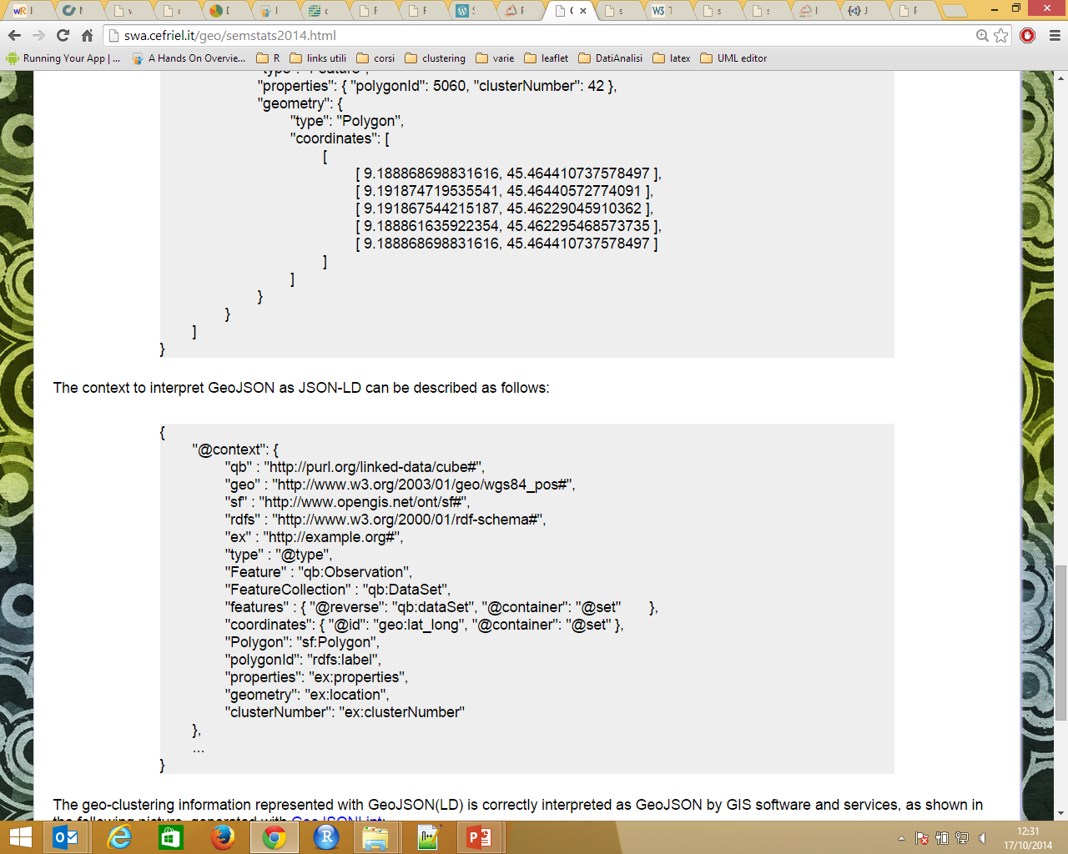
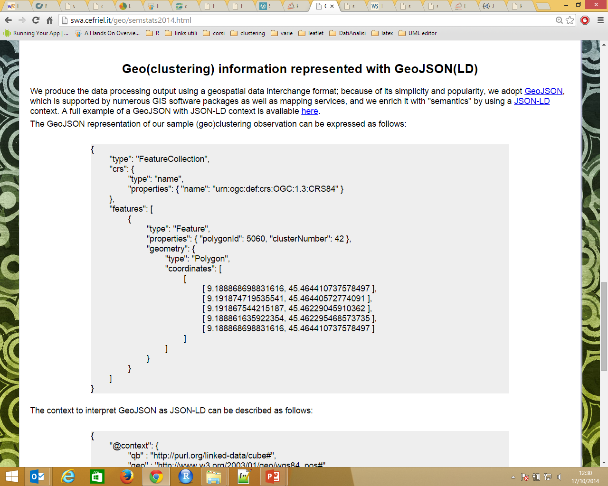
‘’GeoJSON-LD’’
‘’GeoJSON-LD’’ is obtained by adding the ‘@context’ prefix to the GeoJSON file.
The prefix specify how to interpret GeoJSON tags as RDF resources
@context prefix
GeoJSON file
Notes:
A geojson-ld file is obtained by adding the @context the geoJSON file.
This prefix specifies how to interpret the geoJSON tags as RDF resources.

Slide 11

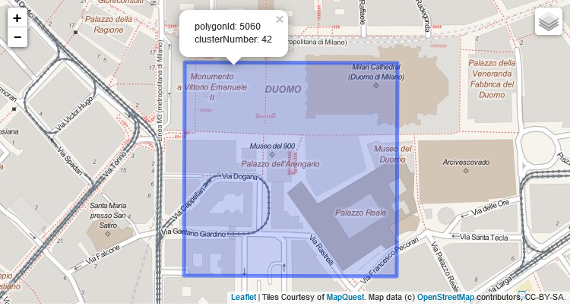
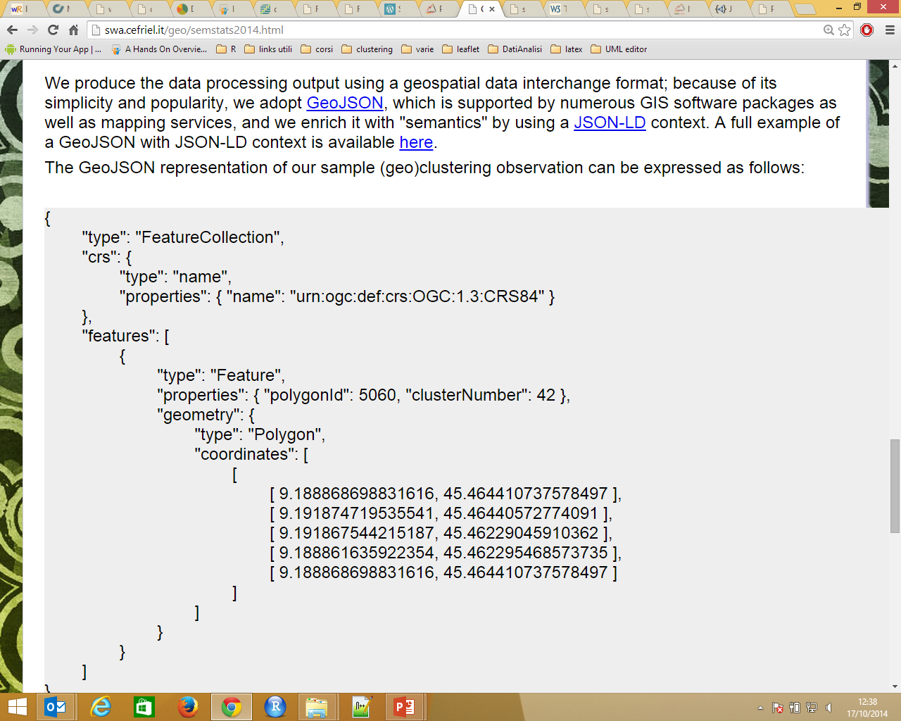
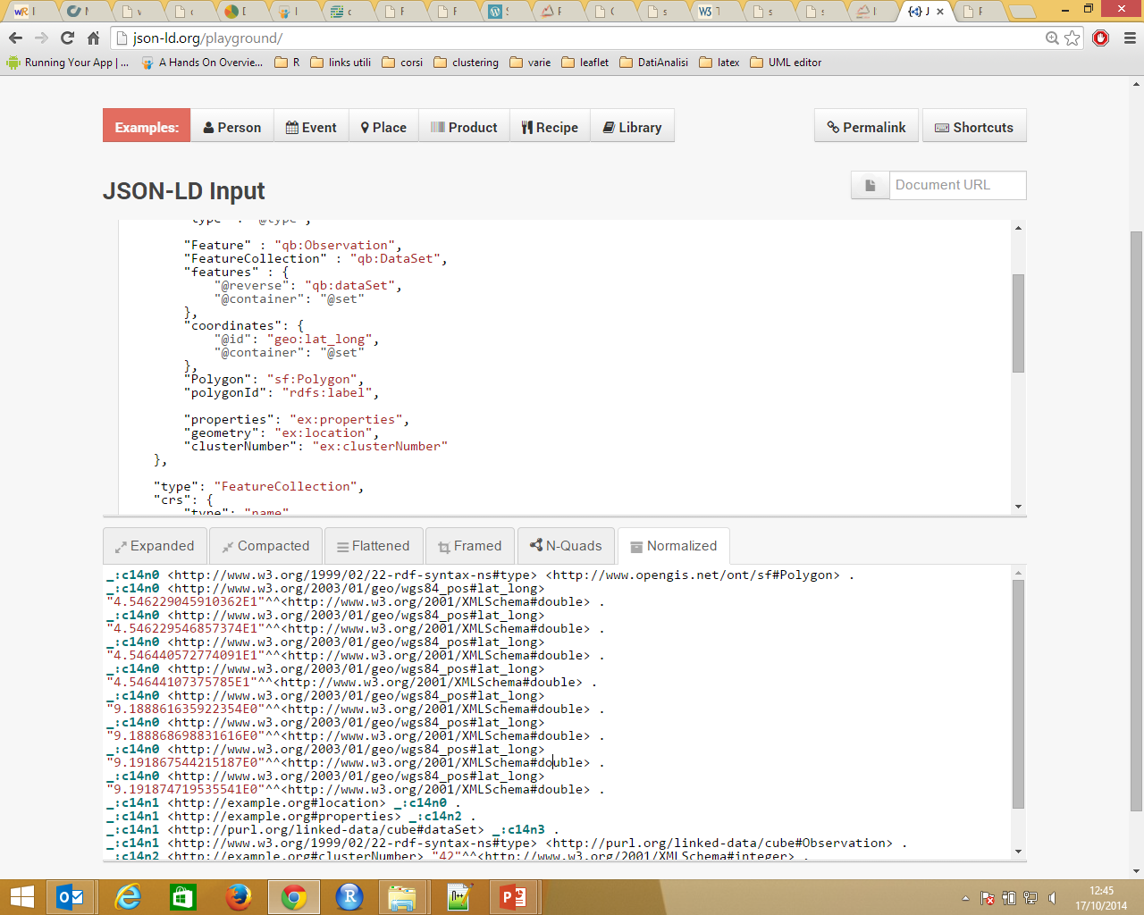
‘’GeoJSON-LD’’ pros and cons
Correct interpretation of the geographic information in the GeoJSON-LD file
Problems in the interpretation of the RDF information.
‘’GeoJSON-LD’’ does not interpret correctly a lists of lists (polygon coordinates representation)
GeoJSON list of lists
RDF serialization
GeoJSON-LD is correctly interpreted as GeoJSON by GIS
Notes:
The resulting geoJSON-LD file is correctly interpreted by GIS system. As you can see from the picture.
On the other hand, there are some problems in the interpretation of geoJSON-LD file in an RDF meaning.
More specifically in a geoJSON file, polygon coordinates are shown as a list of lists, which is not allowed in the current version of JSON-LD.
JSON-LD doesn’t include the concept of list of lists.
In the RDF serialization we have a flat list with the loss of the aggregated information of latitude and longitude.

Slide 12
Conclusion and future works
Identification of a correlation between phone activity data and demographic information
Further tests using different datasets (land use, Point of interests)
Find efficient method for handling the different granularity levels of the datasets
Method for handling temporal aspect of phone activity data (we lost temporal information during clustering process)
Find a method to overcome ‘’GeoJSON-LD’’ serialization problem
Notes:
To sum up, with our work we identify a correlation between phone activity data and demographic information.
Currently we are carring out further experiments with other differents datasets, in order to find if there are further correlations.
An open issue is to find a method to handle the different level of granularity of the datasets and to handle the temporal aspects of the phone activity data. In this work we lost this temporal information during clustering process.
As regards the RDF serialization, future work will be addressed to solve the problems related to the GeoJSON-LD format.

Slide 13
Thank you! Any question? Further details at: http://swa.cefriel.it/geo/
Irene Celino and Gloria Re Calegari
CEFRIEL

